Slide 1


















HOME AUTOMATION USING GESTURES
REG.NO :20BAI1049
NAME GUIDE
: PHAROS SOPHY SAMUEL T J
: BHAVADHARINI R M

Slide 2


INTRODUCTION
Intelligent home automation is growing due to the rise of smart homes.
This system allows users to interact with and control various home devices through simple hand gestures, providing a seamless, touch-free experience.
The core of this project involves the use of CNNs and YOLOv5 for real-time gesture recognition, which ensures accurate and fast identification of hand movements. These gestures are then mapped to specific commands that control smart devices connected through the IoT framework. The Arduino UNO board serves as the intermediary, executing the commands by interfacing with the physical hardware.

Slide 3
A) STATEMENT OF PROBLEM
Aim is to develop a home automation system using hand gestures for
appliance control.
Objective: Recognize hand gestures to translate them into commands using CNN.
User-friendly: Aim for ease of use for people of all ages and abilities.
Key features: Responsiveness, scalability, security, adaptability to various home setups.

Slide 4
B) BACKGROUND, CONTEXT, AND SIGNIFICANCE OF STUDY
Technology revolutionized smart homes for comfort, convenience, and
energy efficiency.
Hand gesture recognition adds hands-free control to home automation. Computer vision and machine learning enable gesture interpretation for effortless appliance control.
Aims to accommodate diverse user needs, including physical limitations. Enhances accessibility, convenience, and efficiency in households.
Contributes to smart home evolution by exploring new interaction methods. Gesture recognition's adaptability suggests broader applications beyond home automation, like healthcare or accessibility solutions.

Slide 5
LITERATURE REVIEW
SL NO ARTICLE TITLE | AUTHOR | PUBLISHER & YEAR | METHODOLOGY | LIMITATIONS
 |  |  | The system
 |  |  | combines an
 |  |  | APDS9960 sensor
Finger Gesture |  |  | and an Arduino UNO
Recognition based | Neha G , Harika CH, |  | board to recognise | The proposed
1 Home Automation | Swetha G , Vishnu | 2023 | hand gestures. The | method can’t track
using IOT | Kanth G |  | board receives a | movements.
 |  |  | signal from this
 |  |  | sensor and uses it
 |  |  | to operate the
 |  |  | gadgets.
 |  |  | This paper presents
Vision based Hand gesture pattern ₂ recognition enabled home automation system using Internet of Things | R Jayanthi, A Bhuvaneswari, S Rajkumar, K P Rama Prabha | 2021 | a Support Vector Machine (SVM) and Convolution Neural Network (CNN) based hand gesture recognition system to automate various home devices. | This method applies applaud recognition but they have not incorporated it fully.

Slide 6
LITERATURE REVIEW
PUBLISHER & YEAR
SL NO
ARTICLE TITLE
AUTHOR
METHODOLOGY
LIMITATIONS
IoT based enabling home automation system for individuals with diverse disabilities
Voice control is facilitated by leveraging an internet-based SpeechTo-Text functionality within MIT App Inventor.
P. Anuradha ,
K. Vasanth ,
G. Renuka , A.Rajeshwar Rao
This method does not work with hand gestures.
3
2023
IoT based home applications controling using vision and gesture through raspberry pi
The user's gesture input is captured using an Android application and sent to the Raspberry Pi , The system uses a convolutional neural network algorithm.
J L SARWANI
Theeparthi
Sape CHittibabulu
This system work with only 4 hand gestures.
4
2023

Slide 7
LITERATURE REVIEW
PUBLISHER & YEAR
SL NO
ARTICLE TITLE
AUTHOR
METHODOLOGY
LIMITATIONS
This paper presents a Support Vector Machine (SVM) and Convolution Neural Network (CNN) based hand gesture recognition system to automate various home devices.
Gestures Controlled Home Automation using Deep Learning: A Review
A. D. Harale , Amruta S. Bankar and K. J. Karande
It work only for close proximity.
5
2021
They propose a RNN. The
architecture comprises two layers of either LSTM or GRU and a Fully Connected output layer.
Hand gesture recognition using recurrent neural networks and synthetic data generation
F. SABBARESE
L.MAGLIULO
P. CARRATU
M. ROMANO
When compared with online scenario,offline scenario doesn’t work good.
6
2023

Slide 8
LITERATURE REVIEW
PUBLISHER & YEAR
SL NO
ARTICLE TITLE
AUTHOR
METHODOLOGY
LIMITATIONS
Enmin Zhong, Carlos R. del- Blanco,
Daniel Berjón , Fernando Jaureguizar and
Narciso García
A hybrid approach that combines 3D Convolutional Neural Networks (3D-CNNs) and Transformers is proposed.
Real-Time Monocular Skeleton-Based Hand Gesture Recognition Using 3D-Jointsformer
7
2023
Requires high GPU.
This project implements computer vision and gesture recognition techniques and develops a software for controlling the media player.
Computer Vision based Media Control using Hand Gestures
Sangamesh
Narayanpethkar
Abhishek Makude
Samrudh S
Yashraj Khose
A. D. Gujar
2023
It works only for pausing media.
8

Slide 9
LITERATURE REVIEW
PUBLISHER & YEAR
SL NO
ARTICLE TITLE
AUTHOR
METHODOLOGY
LIMITATIONS
Aseel Ghazi
Mahmoud,
Ahmed Mudheher Hasan,
Nadia Moqble hassan
Here CNN framework with multiple layers. proposed system provides excellent results of accuracy, precision,recall, and F1-score.
Convolutional neural networks framework for human hand gesture recognition
Doesn’t work for dynamic gesture.
9
2023
Improving Real- Time Hand Gesture Recognition with Semantic Segmentation
Gibran Benitez Garcia,
Lidia Prudente-Tixtecoa,
Luis Carlos Castro Madrid,Rocio Toscano-Medina
Here, they employ a light-weight semantic segmentation method (FASSD- Net).
Requires high computational cost.
10
2021

Slide 10
LITERATURE REVIEW
PUBLISHER & YEAR
SL NO
ARTICLE TITLE
AUTHOR
METHODOLOGY
LIMITATIONS
Dr.China
Venkateswarlu
Sonagiri,
Dr.Puralasetty Ashok Babu,
Vijay Vallabhuni,
Sivanagaraju Veerastu
Artificial Intelligence Based Smart Home Automation System Using Internet of Things
The microcontroller is configured with an artificial intelligence trained algorithm.
There is a lack in dataset.
11
2021
Utilizing ML for Hand Gesture Recognition
Vaidish Srivastava,
Srajan Shukla,
Radhey Shyam
CNN , RNN and Transformer are being used.
provides low accuracy.
12
2023

Slide 11
LITERATURE REVIEW
PUBLISHER & YEAR
SL NO
ARTICLE TITLE
AUTHOR
METHODOLOGY
LIMITATIONS
Gesture Vocabularies for Hand Gestures for Controlling Air Conditioners in Home and Vehicle Environments
Modified gesture vocabulary (CrossG) is used.
Works only for 13 gesture patterns.
13
Hasan J.Alyaman
2023
Mafidul Islam,
Deepiyoti Mahanta,
Dr.Kaustubh
Bhattacharyya,
Maidul Islam,
Design here is controlled by Arduino UNO and hand gesture is recognised by APDS9960 sensor.
HOME AUTOMATION SYSTEM
Works only for up,right,left,down gestures.
14
2023

Slide 12
LITERATURE REVIEW
PUBLISHER & YEAR
SL NO
ARTICLE TITLE
AUTHOR
METHODOLOGY
LIMITATIONS
B.Latha, Sri
Sowndarya,
Swethamalya. K,
Mr.Ashish Raghuwanshi,
Eakhmatova Feruza,
Mr.G.Sathish kumar
Hand Gesture and Voice Assistants
Based on a convolutional neural network .
Accuracy low due to background noise.
15
2023

Slide 13



PROBLEM STATEMENT
Controlling appliances through buttons and tangible devices has been the
traditional way.
This project aims at enhancing the human-computer interaction by using gestures as a command input thus making things even more convenient.
Given times where people might feel too lazy or tired to give voice commands, simple gestures or actions could make the communication process easier.
Moreover, such gesture based home automation greatly aids the speech impaired people to interact with smart devices at home, possibly.
Instead of taking a single picture, we record frames of the movement through cameras that detect the gestures delivered.

Slide 14
RESEARCH CHALLENGES
Gesture Recognition Accuracy
Adaptability to User Variability Real-time Processing
Environmental Variability Gesture Standardization Privacy and Security
User Experience and Accessibility Scalability and Integration

Slide 15


RESEARCH OBJECTIVE
Goal: Create a gesture-based home automation system which controls the
fan speed and brightness of a bulb & a led.
Technology: Uses computer vision & machine learning for hand gesture recognition.
Benefits: Enhances convenience, accessibility, and efficiency in daily living.

Slide 16
METHODOLOGY : A) ALGORITHMS
Background Subtraction:
Purpose: Identify moving objects (hands) against a static background.
Algorithm: Gaussian Mixture Models (GMM), Running Gaussian Average, or adaptive algorithms to model background and foreground.
Hand Detection:
Purpose: Locate and isolate the region of interest containing the hand.
Algorithm: Haar Cascades, Histogram of Oriented Gradients (HOG), Convolutional Neural Networks (CNNs), or deep learning-based approaches for object detection.

Slide 17


















Hand Tracking:
Purpose: Continuously track the movement of the hand.
Algorithm: Kalman Filters, CamShift algorithm, or methods based on optical flow.
Feature Extraction:
Purpose: Extract relevant features from the hand or its movements for gesture recognition.
Algorithm: Scale-Invariant Feature Transform (SIFT), Speeded-Up Robust features (SURF), or custom feature extraction methods.
Gesture Recognition Libraries and APIs:
Purpose: Utilize pre-built libraries and APIs for faster development.
Examples: OpenCV (with its gesture recognition modules), MediaPipe, TensorFlow Gesture Recognition API, or other machine learning libraries.

Slide 18
5. Gesture Recognition:
Purpose: Recognize specific gestures from extracted features.
Algorithm:
Machine Learning: Support Vector Machines (SVM), Random Forests, k-Nearest Neighbors (k-NN), or neural networks trained on hand-crafted features.
Deep Learning: Convolutional Neural Networks (CNNs), Recurrent Neural Networks (RNNs), or Convolutional LSTM networks trained on raw or preprocessed hand gesture sequences.

Slide 19
B) DATA COLLECTION APPROACHES/STRATEGIES
Sensor-Based Data Collection:
Approach: Use sensors (cameras, depth sensors) to capture hand gesture data in controlled environments.
Diverse Gesture Representation:
Approach: Collect data encompassing a wide range of gestures, hand poses, orientations, and speeds.
Multi-Modal Data Fusion:
Approach: Combine data from different sensors (e.g., RGB and depth cameras) to enhance gesture representation.

Slide 20
B) DATA COLLECTION APPROACHES/STRATEGIES
Annotation and Labeling:
Approach: Manually annotate or label the collected data with corresponding gestures or actions.
Data Augmentation:
Approach: Introduce variations in the collected data through techniques like rotation, scaling, or adding noise.
Continuous Data Collection and Iteration:
Approach: Continuously collect new data and update the model based on real- world usage and feedback.

Slide 21
A) ADVANTAGE OF STRATEGY
Improved Model Performance: High-quality and diverse data lead to more
accurate and robust models.
Generalization: Models trained on comprehensive datasets can generalize better to unseen gestures or variations.
Adaptability: Regular data collection and updates facilitate adaptation to changing user behaviors or needs.
Reduced Bias: Ensures models are trained on representative datasets, reducing biases in gesture recognition.

Slide 22
B) LIMITATION OF STRATEGY
Limited Diversity in Data
Dependency on Controlled Environments
Annotation Errors and Subjectivity
Limited Dataset Size
Overfitting and Underfitting
Privacy and Ethical Considerations
Dynamic User Behavior and Gestures

Slide 23
C) POTENTIAL RISK
Misinterpretation of Gestures
Security and Unauthorized Access
Privacy Concerns
Dependency on Environmental
Factors Limited Accessibility
System Reliability and Failures
Dependency on Technology

Slide 24
E) DATA ANALYSIS APPROACHES
Feature Extraction
Dimensionality Reduction Gesture Segmentation
Sequence Modeling
Classification and Recognition Hyperparameter Optimization Real-Time Analysis
Continual Learning and Adaptation

Slide 25
PROPOSED SYSTEM - A) PROPOSED SYSTEM
Our proposed hand gesture-controlled home automation system aims to
revolutionize the way users interact with their smart homes.
This system aspires to offer a more accessible, convenient, and futuristic approach to home automation.
The primary objective of this system is to create a seamless and effortless user experience by allowing individuals to control their home environment without physical touch or voice commands.
By employing advanced gesture sensing hardware and robust gesture recognition algorithms, the system interprets hand movements, translating them into commands that operate lighting, appliances, entertainment systems, and other home devices.

Slide 26
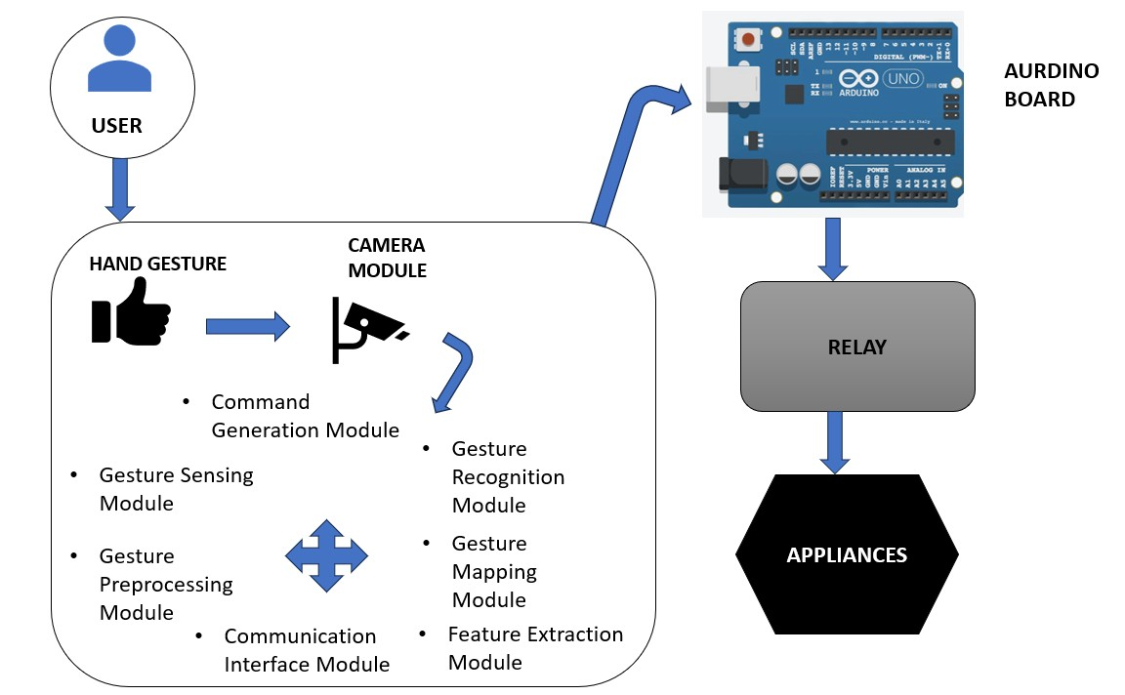
B) PROPOSED SYSTEM DIAGRAM

Slide 27
C) LIST OF MODULES
Gesture Sensing Module
Gesture Preprocessing Module Feature Extraction Module Gesture Recognition Module Gesture Mapping Module
Command Generation Module
Communication Interface Module Home Automation Control Module

Slide 28
D) EXPLANATION OF ALL THE MODULES
1. Gesture Sensing Module:
Hardware: Cameras, depth sensors, or specialized gesture-sensing capturing hand movements.
Functionality: Captures real-time hand gestures within a defined space.
devices
2. Gesture Preprocessing Module:
Functionality: Cleans and preprocesses raw gesture data, removing noise or irrelevant information.
Tasks: Filtering, noise reduction, background subtraction.

Slide 29
3. Feature Extraction Module:
Functionality: Extracts relevant recognition.
features from preprocessed gesture data for
Techniques: Histogram of Oriented Gradients (HOG), keypoints (SIFT, SURF), or other
feature extraction methods.
4. Gesture Recognition Module:
Algorithms: Convolutional Neural Networks (CNNs), Hidden Markov Models (HMMs), or other recognition models.
Tasks: Interprets extracted features, recognizes specific hand gestures.

Slide 30
Gesture Mapping Module:
Functionality: Maps recognized gestures to predefined commands or actions. Tasks: Associating gestures with specific functions (e.g., turning lights on/off).
Command Generation Module:
Functionality: Generates control signals or commands based on recognized gestures. Tasks: Converting recognized gestures into actionable commands for home devices.

Slide 31
7. Communication Interface Module:
Protocols: Wi-Fi, Bluetooth, Zigbee, or other communication protocols.
Tasks: Facilitates data exchange between processing units and home automation devices.
8. Home Automation Control Module:
Functionality: Interfaces with smart devices/appliances for control generated commands.
Devices Controlled: Lights, thermostats, entertainment systems, etc.
based on

Slide 32
WHAT IS TO BE DONE NEXT
The hardware part is to be completed

Slide 33
RESEARCH PAPER
Finished Literature Survey and working on Introduction

Slide 34
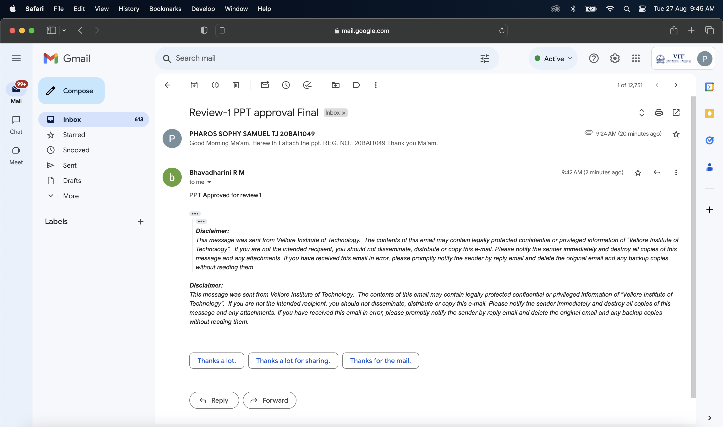
GUIDE APPROVAL

Slide 35
REFERENCES
[1] https://www.ijraset.com/best-journal/finger-gesture-recognition-based-home-automation-using-iot
[2]https://www.researchgate.net/publication/354046870_Vision_based_Hand_gesture%20pattern_recognition_ena%20bled_home_automation_system_using_Internet_of_Things
[3] https://www.sciencedirect.com/science/article/pii/S2772671123002619
[4]https://www.researchgate.net/publication/372984441_IOT_BASED_HOME_APPLICATIONS_CONTROLING_USING_VISION_AND_GESTURE_THROUGH_RASPBERRY_PI
[5]https://www.researchgate.net/publication/359801928_Gestures_Controlled_Home_Automation_using_Deep_Learning_A_Review
[6]https://www.researchgate.net/publication/373923804_HAND_GESTURE_RECOGNITION_USING_RECURRENT_NEURAL_NETWORKS_AND_SYNTHETIC_DATA_GENERATION

Slide 36
REFERENCES
[7] https://www.researchgate.net/publication/373066982_Real-Time_Monocular_Skeleton-%20Based_Hand_Gesture_Recognition_Using_3D-Jointsformer
[8]https://www.researchgate.net/publication/371230969_Computer_Vision_based_Media_Control_using_Han%20d_Gestures
[9]https://www.researchgate.net/publication/353624643_Convolutional_neural_networks_framework_for_human_hand_gesture_recognition
[10]https://www.researchgate.net/publication/348308219_Improving_RealTime_Hand_Gesture_Recognition_with_Semantic_Segmentation
[11]https://www.researchgate.net/publication/352167439_Artificial_Intelligence_Based_Smart_Home_Automation_System_Using_Internet_of_Things#fullTextFileContent
[12]https://www.researchgate.net/publication/374846019_Utilizing_ML_for_Hand_Gesture_Recognition

Slide 37
REFERENCES
[13]https://www.researchgate.net/publication/369488379_Gesture_Vocabularies_for_Hand_Gestures_for_Controlling_Air_Conditioners_in_Home_and_Vehicle_Environments
[14] https://www.researchgate.net/publication/374388028_HOME_AUTOMATION_SYSTEM
[15]https://www.researchgate.net/publication/372339326_Hand_Gesture_and_Voice_Assistants

Slide 38

Thank You

